Slide 1
Boolean operations in CSG

Slide 2
Constructive solid geometry (CSG)
CSG is one of a fundamental theories of varies 3D modelling CAD system.
Boolean operations of multi-bodies
One of ideas in CSG is that some algebraic calculations can be performed between two bodies.
There are three basic Boolean operations of bodies, which are named unite, difference and intersect, derived from set theory. However, in Solidworks, they are called add, subtract and common, respectively.
Through Boolean operations one can take uses of several bodies to generate a new body.

Slide 3
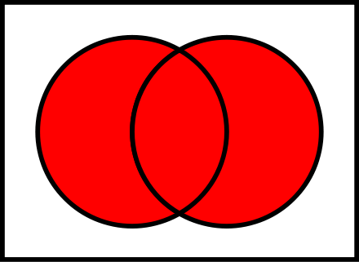
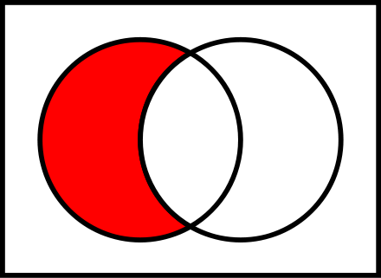
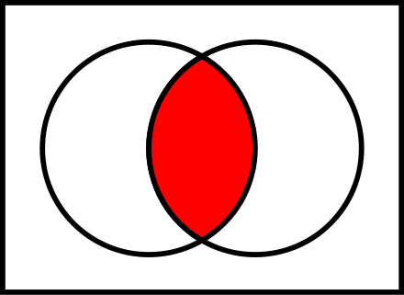
Boolean operations in set theory
In set theory, we have

Slide 4
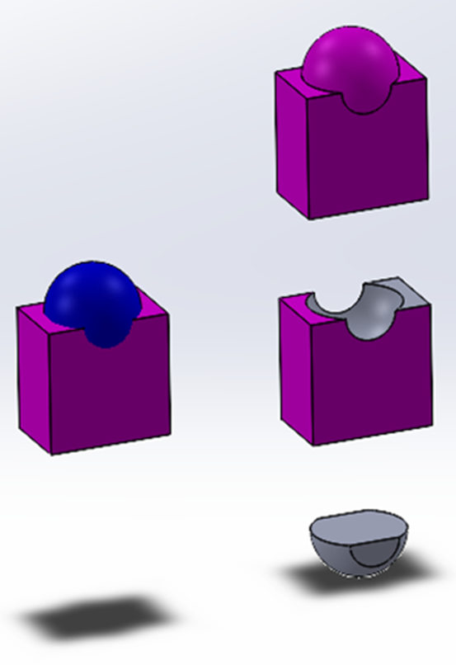
Boolean operations of multi-bodies
Target: The body with the finished geometry is called the target;
Tool: The body used to create or edit the shape is called the tool.

Slide 5
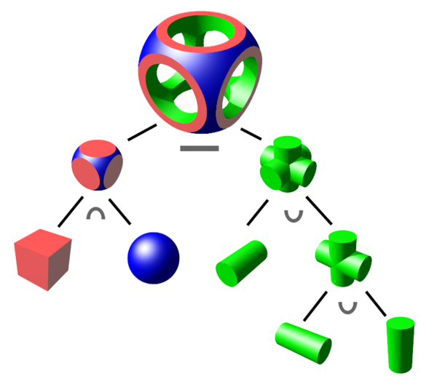
Boolean logic with binary tree
A binary tree structure is usually used to store the basic bodies one lead nodes, the operations on the internal nodes, and the final body on the root node.

